Slide 1

Electric Fencing Workshop
Jacob S Pelham
Wildlife Technician
Department of Fish & Game
Wildlife Conservation
43961 Kalifornsky Beach Rd, Suite B
Soldotna, Alaska 99669
Phone: 907.260.2913
Notes:
Hello and welcome (introduction)

Slide 2
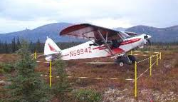
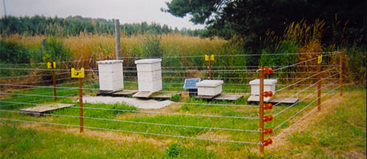
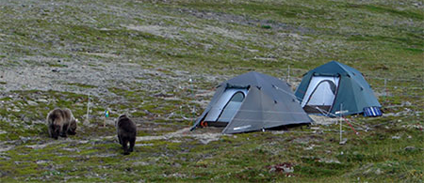
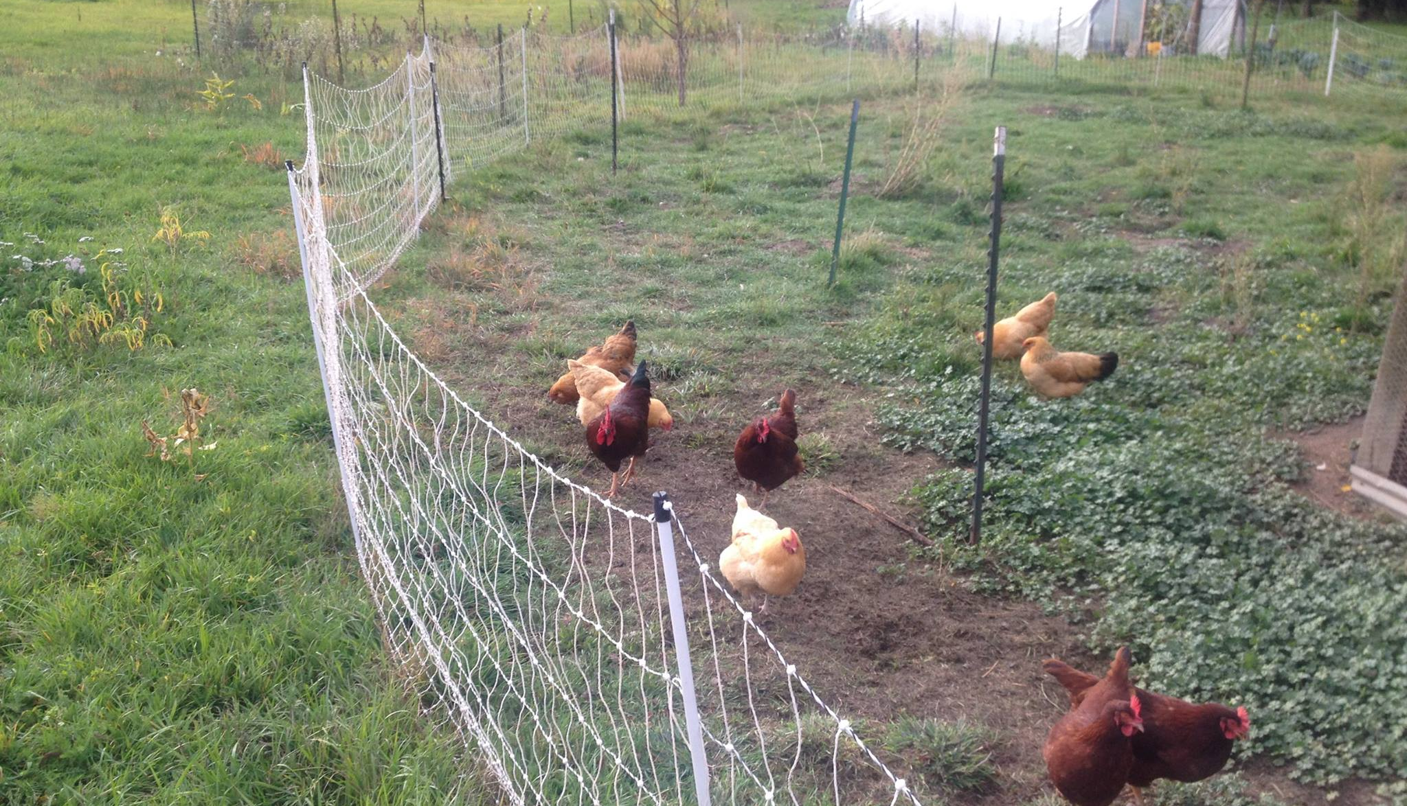
Notes:
The goal of all of this is TO REDUCE CONFLICT
No one likes conflict and with good practices, we can minimize it.
Many configurations and set ups.
Electric fences can be used in remote settings and in your back yard.

Slide 3
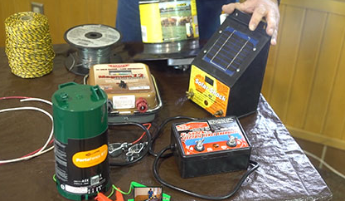
What Can you use an Electric Fence for??
Fruit Trees
Chicken Coops
Livestock Pens
Livestock Food
Dog Pens
Compost
Harvested Game
Seasonal Cabins
Back Country Camps
Garbage Containers
Beehives
Outbuildings
Orchards
Birdfeeders
Porches
Sheds
Yurts
Gardens
Outdoor Freezers
Refrigerators
Smokers
Airplanes
Notes:
Anything that you want to keep wildlife away from, you can build and electric fence around

Slide 4
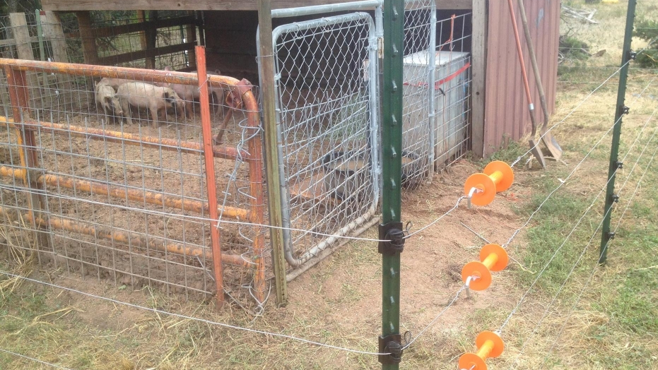
Electric Fences Work!!
Multiple electrified wires
Combination of electrified and ground return wires
Combination of electrified wires on the outside of an existing fence
OR prefabricated electrified netting
At least 5 strands, 4-5 ft tall and ideally 7,000 Volts
Notes:
We want to prevent wildlife conflict.
Bears learn habits (good and bad) very quickly. Electric fences teach them the consequences of messing with human associated property/livestock.

Slide 5

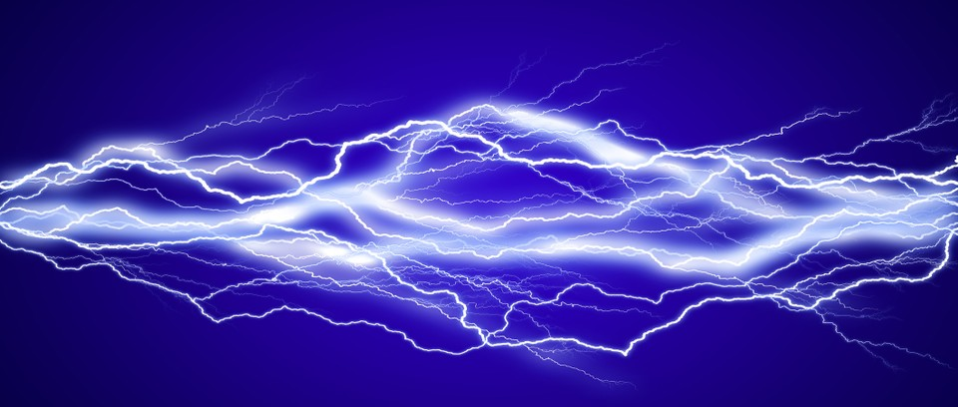
A Quick Explanation of Electric Definitions
Joule--equal to the work done by a force of one newton when its point of application moves one meter in the direction of action of the force, equivalent to one 3600th of a watt-hour.
Volt--the difference in electric potential between two places.
    1 volt = 1 Joule per coulomb
Coulomb--equal to the quantity of electricity conveyed in one second by a current of one ampere. (One ampere is equal to the flow of one coulomb of a charge in a second)
V=IR
E_{(J)} = V_{(V)} × Q_{(C)}
Notes:
Not spending much time on this, providing background when I start talking about volts and joules on energizers.
Voltage= current times resistance (ohms law)
joule = volt × coulomb

Slide 6
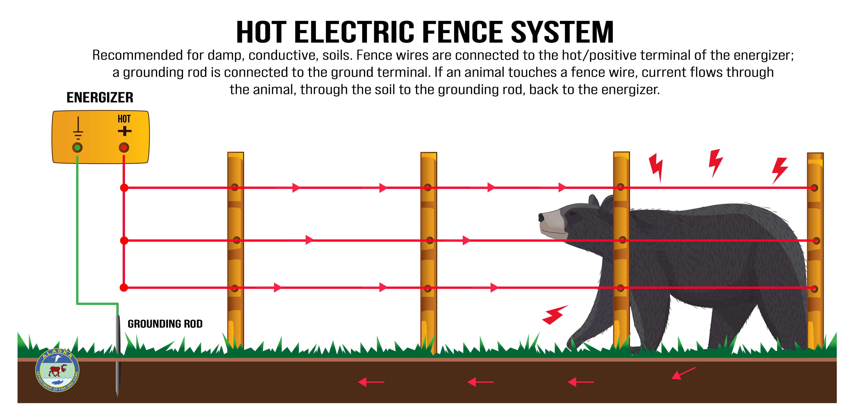
Notes:
All Hot fences: Every wire on this fence is hot.
One wire is directly connected to the positive terminal on the energizer. All the remaining wires are connected in a series to each other. The negative terminal is connected to the ground rod(s) completing the circuit. When the animal is standing on the soil, and touches just one of the electric wires, with will be shocked. The electric current travels from the energizer through the wire, through the animal, into the soil, to the grounding rod and back to the energizer.

Slide 7
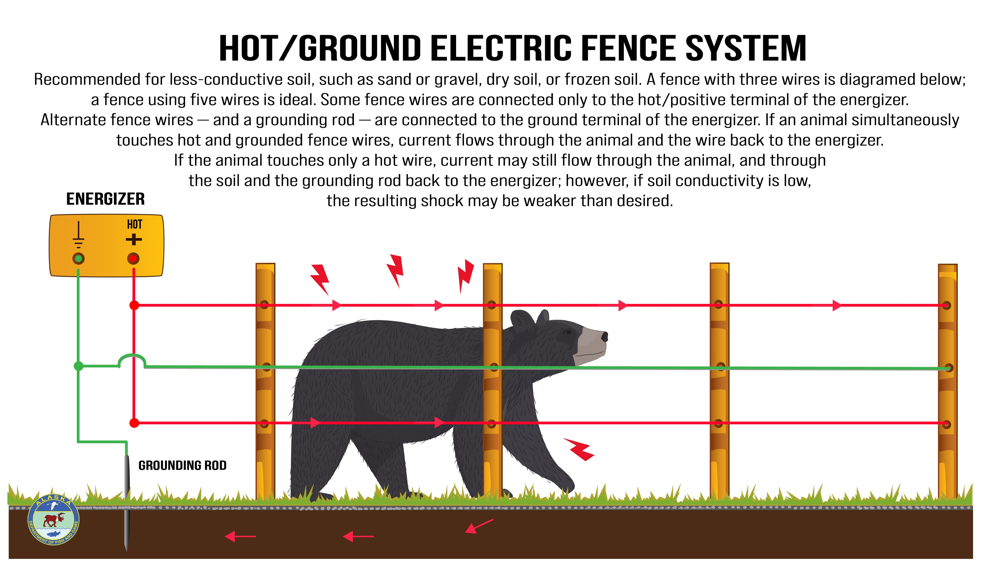
Notes:
Alternating hot and ground wires: One hot wire is connected to the energizer while the remaining hot wires are connected in a series. Similarly one ground wire is directly connected to the energizer while the other ground wires are connected in a series. The ground rod is directly connected to the ground terminal on the energizer. With this design, the electric current is returned directly back to the energizer through all the ground wires instead of relying on conducting electricity through the soil and grounding rod.
The animal need will touch both a hot and ground wire to receive a shock. This design helps compensate conductivity in areas with dry soil resulting in poor ground return.

Slide 8
Notes:
Many good examples of diagrams and sources online
A minimum of 5 wires is recommended.
In alternating hot ground fences, the top and bottom wire should be hot.
The lowest wire should be 8-12 inches above the ground and the fence should be 4 feet tall min.
Long term remote needs solar
The bigger and better is more expensive

Slide 9
Parts of an Electric Fence
1) Energizer
2) Conductors
3) Fence Posts
4) Ground Rod(s)
5) Insulators and Gate Handles
6) Tester
Notes:
There are 6 main components necessary for a functional electric fence.

Slide 10
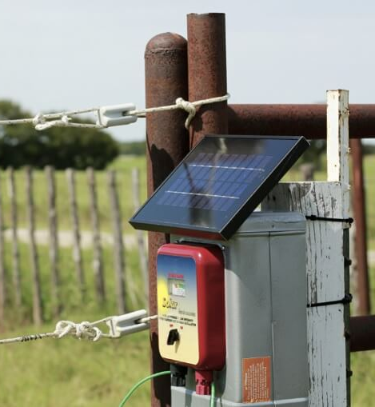



Fence Energizers
110V-AC
DC Battery
Solar with rechargeable DC Battery
https://morninghomestead.com/wp-content/uploads/2018/11/Best-Electric-Fence-Charger-For-Cattle.jpg
Notes:
There are 3 types of Fence energizers. Each one has different advantages and disadvantages regarding price, functionality, and deployment ease.
110V-AC energizers plug directly into a wall socket, these are very easy to use, reliable and cost effective
DC Battery energizers rely on a 12-volt deep cycle battery for charge. Needs to be monitored and charged.
Solar panels maintain the charge on a DC battery system. Used where electricity is not available.

Slide 11
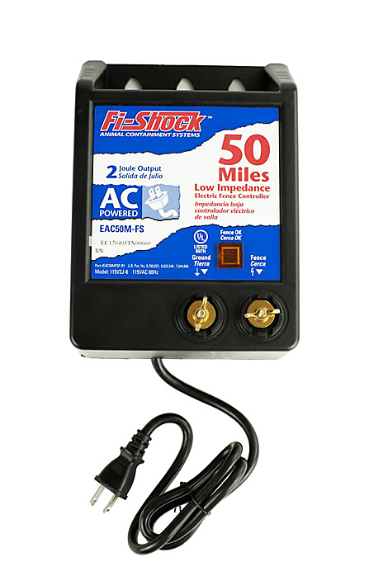
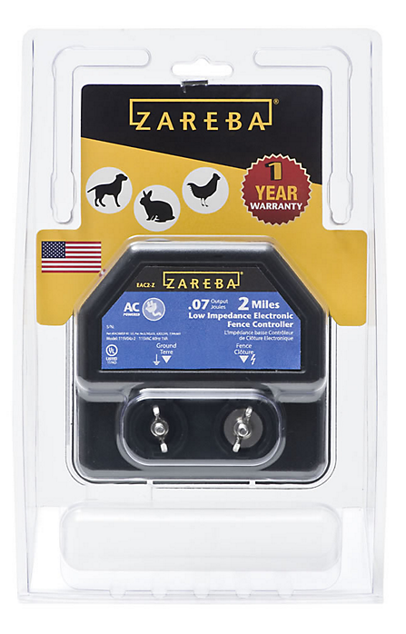
AC Low Impedance
Least costly type and cheapest to buy and operate
Standard pulse rate of 50-60 pulses per minute
Receives consistent power and requires less maintenance
More sensitive to the outside environment
Notes:
These usually need protection from the environment.
Wall plug in
Reliable if they are protected from weather
2 joule Fi-Shock 129.99 msrp
1 joule 25 mile is 99.99
Zareba is 39.99

Slide 12
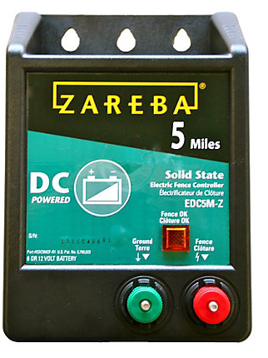
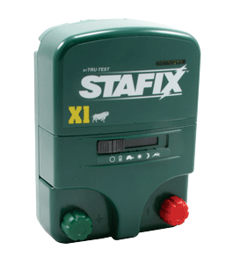
DC Battery
12 Volt or 6 Volt systems
  Deep Cycle or Marine Battery
More versatile for placement and use
More costly when the price of the battery is included
Usually a slower pulse rate (recommended 45-60 pulses per minute)
Requires more regular maintenance
Notes:
More versatile and mobile than the AC unit.
Stafix is a dual AC/DC system, 1 joule is listed at 149.75 at Kencove.com
Zareba: 79.99
7.3KV

Slide 13
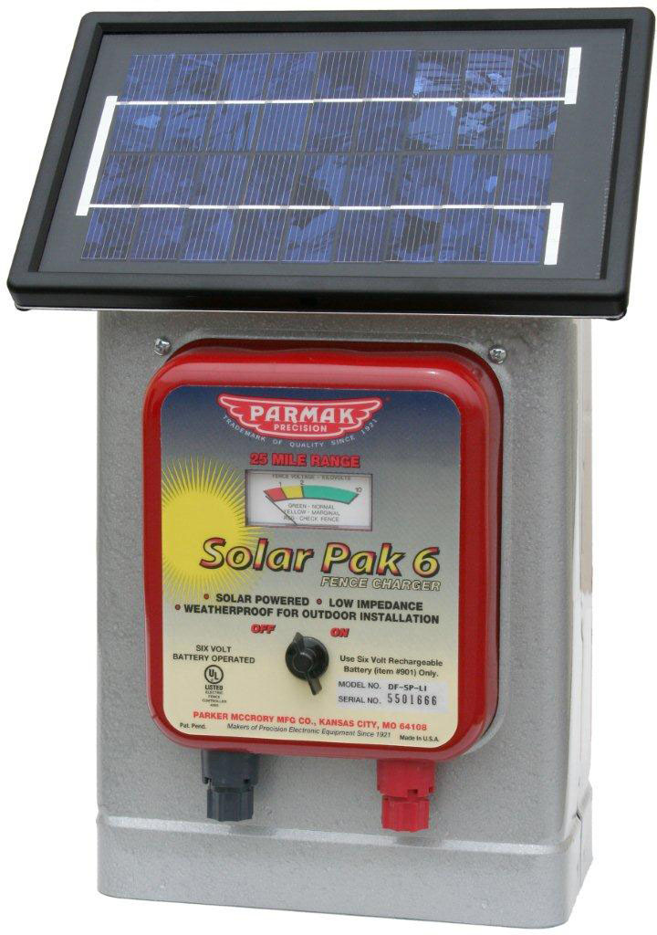
Solar
Consists of a solar panel directly attached to a rechargeable battery and DC energizer
Often sold as a single unit
Solar panels can be bought separately and used with an existing DC Charger.
  Make sure array is large enough to keep battery charged
Solar panels need sun!!!
Notes:
This is a DC Battery system with solar recharge.
Can be set anywhere.
More maintenance

Slide 14
Conductors
Aluminum
Stainless Steel
Polywire
Turbo Wire
Poultry Netting
Polytape

Slide 15
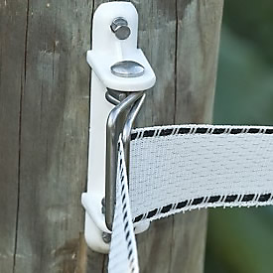
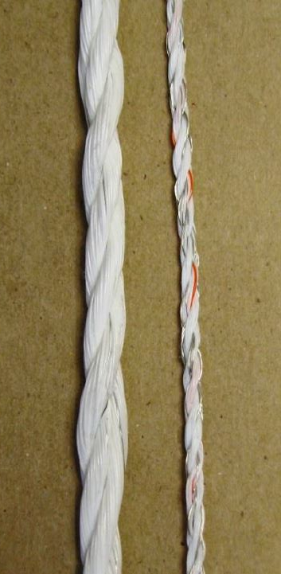
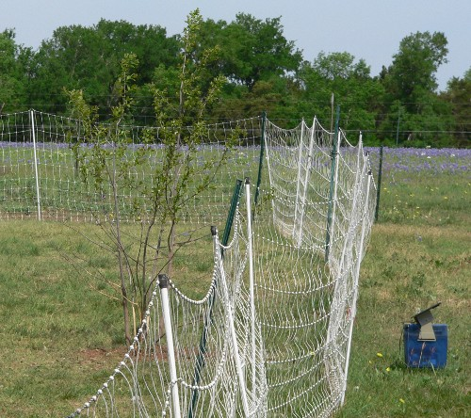
Temporary
Polyethylene wire
    Polywire, Polytape, Turbowire, Poultry Netting
  Multiple strands of wire braided within a polyethylene rope.
  Flexible, strong, easy to deploy and store.
  Ideally 9 strands of wire within the poly
  Will degrade and break over time after long exposures to sun

Slide 16
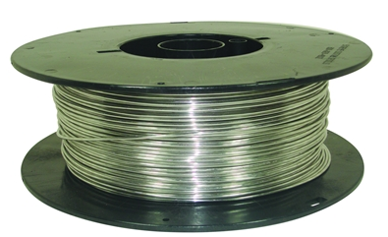
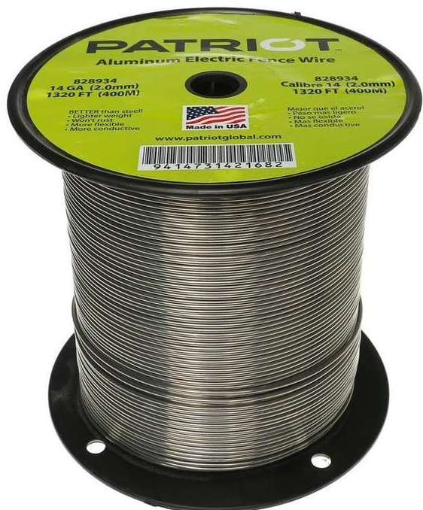
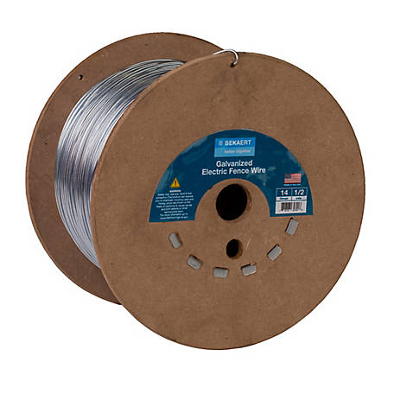
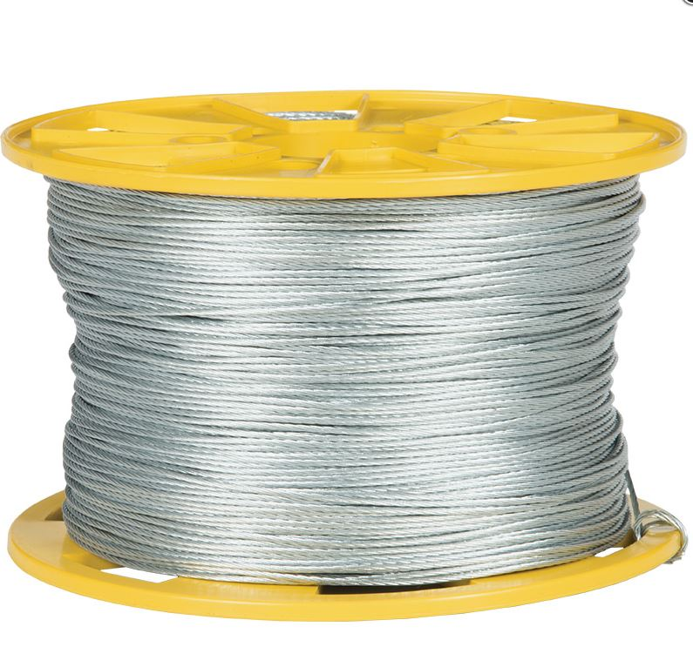
Permanent
Field Guardian 12 1/2 GA Aluminum
Wire
  Galvanized smoothed steel
    Strong, durable, but rigid
  Aluminum
    Lightweight, easy to work with, breaks after repeated bending.
  MaxiShock Wire
12-14-gauge wire
  Longer distances smaller gauge wire, up to 10 gauge
Bekaert Galvanized
Patriot Aluminum Wire
MaxiShock
Notes:
Field Gurdian 12 ½ ga 1000’ 59.99 Aluminum
Patriot wire 62.99 ¼ Aluminum
Bekaert wire 27.99 ¼ Galvanized
MaxiShock Wire 116.00 ½ mile
Has a very thick outer coating of zinc (Class IV). So it will last up to 10 years without rusting in humid climates.
Low tensile strength. Therefore, it's very easy to wind, unwind, cut, tie and join. MaxiShock allows simple, conductive, long-lasting connections without any tools other than side-cutting pliers.

Slide 17
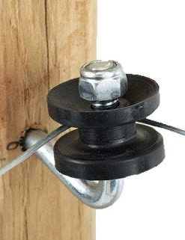
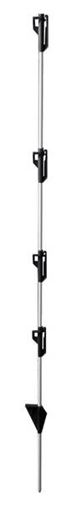
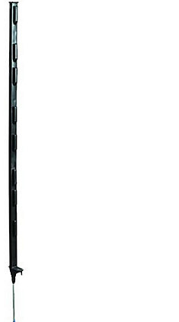
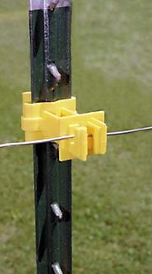
Fence Posts
Reinforced Polypropylene
Wood
Metal T-Posts
Fiberglass
Reinforced Polypropylene
SunGUARD II Fiberglass Step - In Fence Post
Notes:
SunGUARD II Fiberglass Step - In Fence Post 1.99 each farmandfleet.com
Zareba® Black Step-In Fence Post
Molded of reinforced polypropylene with a heavy-duty steel stake 2.99 each

Slide 18
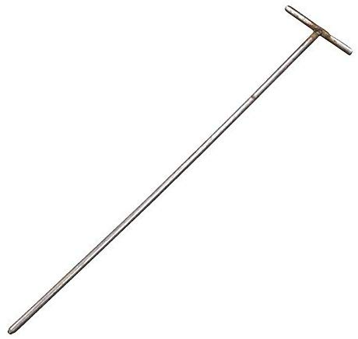
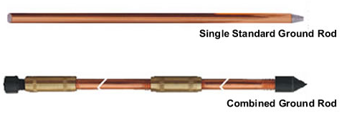
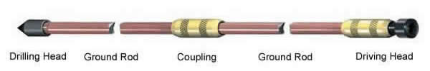
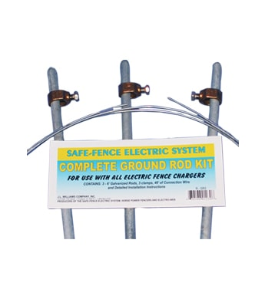
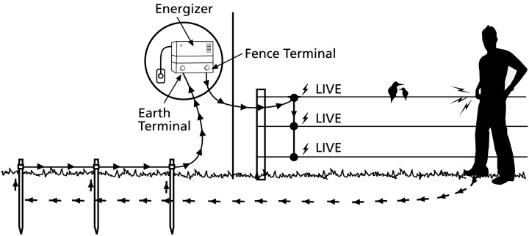
Grounding Rods
Over 90% of problems with electrifying fences is attributed to insufficient grounding
4’ long and ½’’ in diameter
Moist ground
The better the ground, the better the shock
Notes:
The combined copper-clad steel ground rod are consist of drilling head, copper-clad steel ground rod, coupling and driving. the difference between the combined copper-clad steel ground rod and the single standard ground rod.

Slide 19
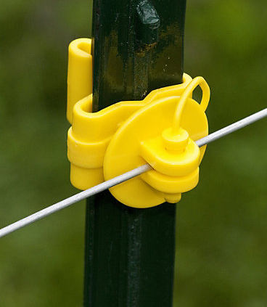
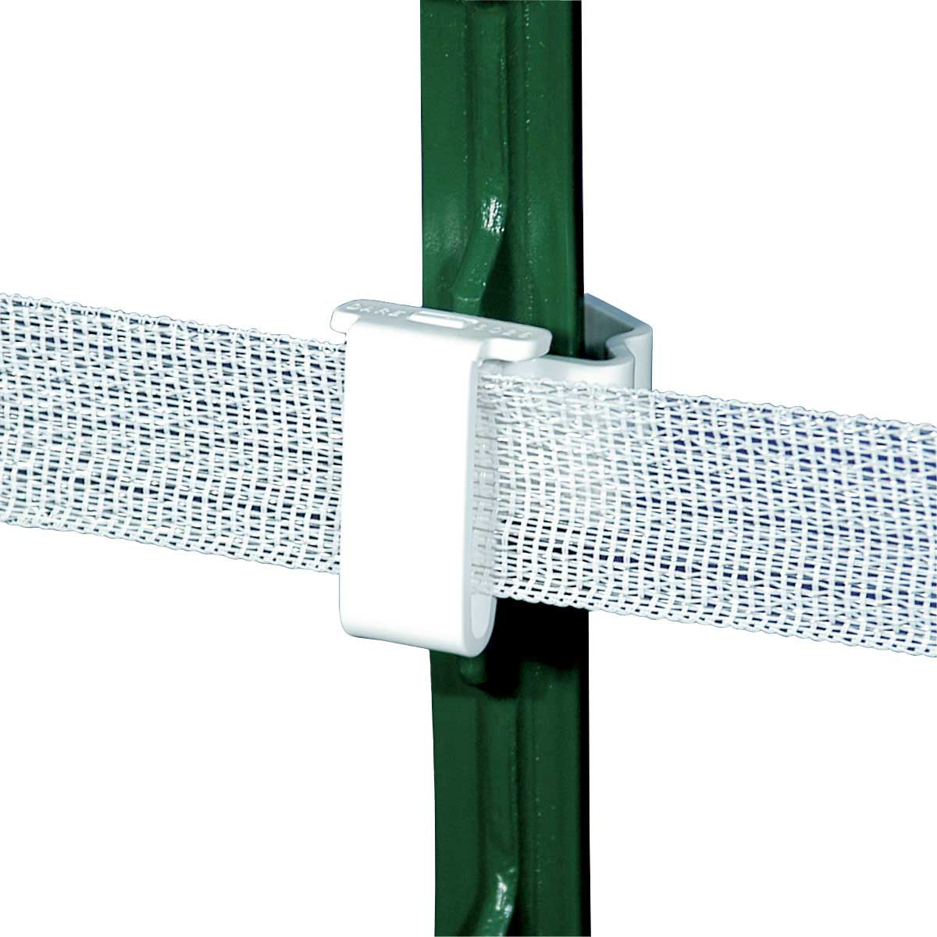
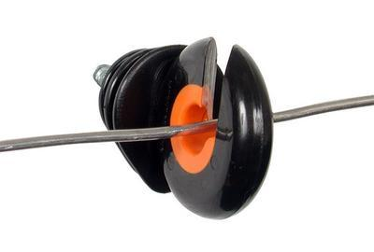
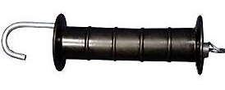
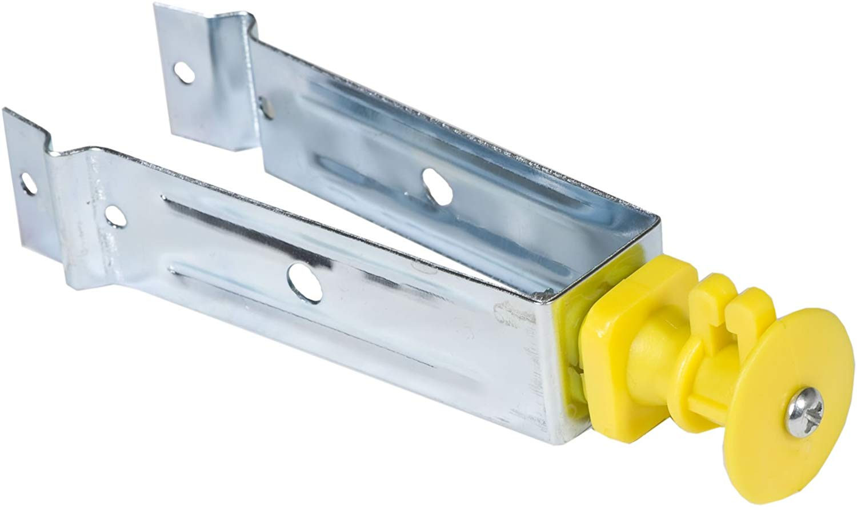
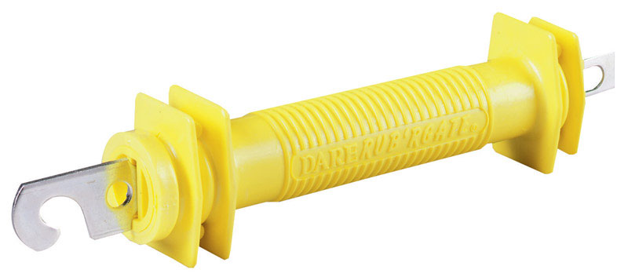
Insulators and Gate Handles
Notes:
7.99 for 25 pack, yellow tee post insulators

Slide 20
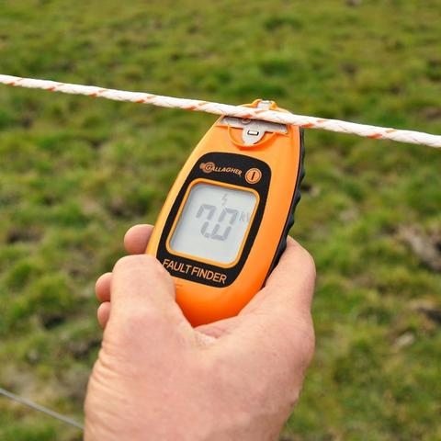
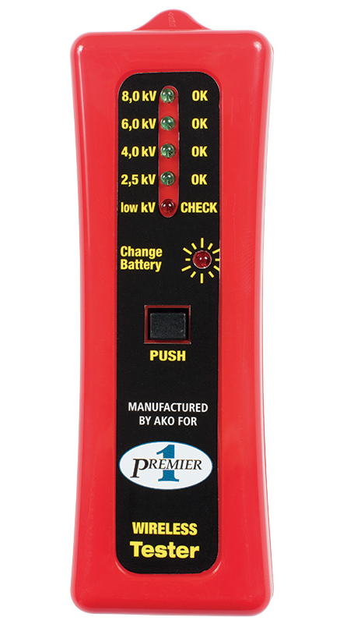
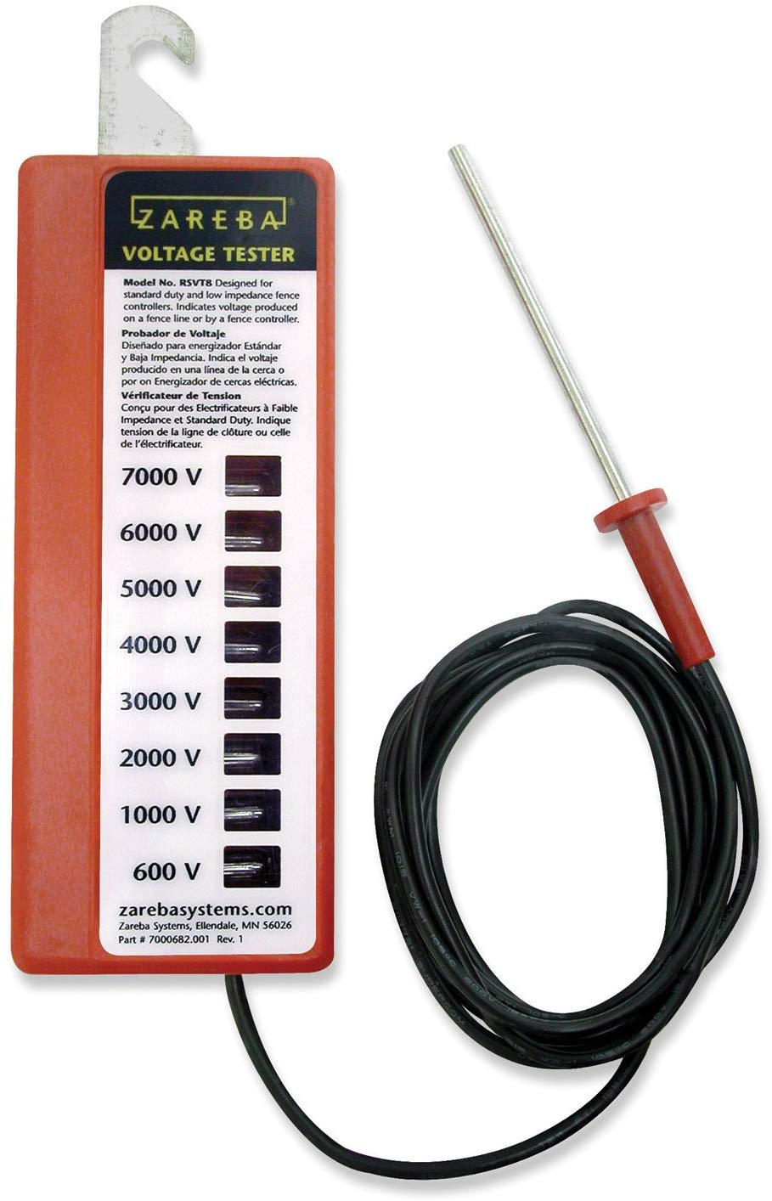
Tester
Maintenance requires testing your fence on all wires after installation and through its uses period to insure functionality .
Notes:
Gallagher smartfix fault finder – 119.99 used to identify where a fault in your system is. Usually this is convenient when you have miles of fence on a ranch
Zareba voltage tester is 16.99
Preimer1 5 light tester is 15.00

Slide 21
Common Questions about Electric Fencing
Are electric fences a fire hazard?
No, While energizers used to have a fire hazard risk, modern energizers do not have this same risk. Short pulses and low amperage have improved the safety when it comes to starting fires.

Slide 22
Common Questions about Electric Fencing
Are electric fences safe for people and animals?
Yes, because electricity pulsates rather than flow constantly and the energizer provides a shock at low impedance and low amperage, you cannot get “stuck” to the wire.

Slide 23
Common Questions about Electric Fencing
Is electric fencing more expensive than a standard barbed wire fence?
No. In fact when comparing costs, a well built 5 strand electric fence versus the same quality and size barbed wire fence, the electric fence will be about 2/3 the cost of the standard barbed wire fence.

Slide 24
Common Questions about Electric Fencing
Will I get shocked by an electric fence if I am wearing rubber boots?
No, the rubber acts as an insulator keeping the electricity from grounding and therefore not completing the circuit.
*unless you touch the ground with you hand providing a grounding route for the electricity.

Slide 25
Common Questions about Electric Fencing
If wood is an insulator, why can I not wrap the wire around the post instead of using a separate insulator.
  Wood is a good insulator, and this would prove functional until it rains, or the wood gets wet which would the short the whole system.

Slide 26
Common Questions about Electric Fencing
If I jump in the air and while I am in the air, I touch the electric fence, will I still get shocked?
No, you are not “grounded” and therefore not completing the circuit. This is the same reason that birds can sit on electrified wires and not get shocked.

Slide 27

Questions?
Thank you

