Slide 1
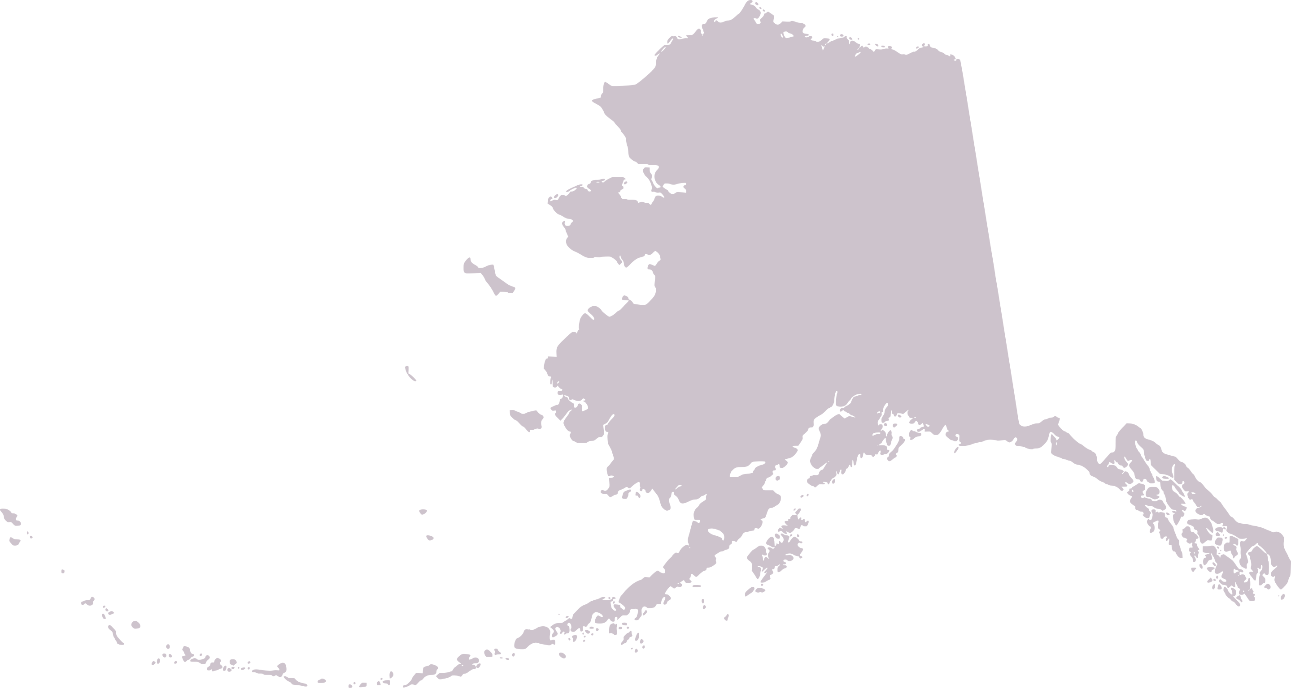
Research Priorities, Unobserved Fishing Mortality, and next steps
Dr. Chris Siddon, Chief Scientist for Marine Fisheries
ADF&G, Commercial Fisheries

Slide 2
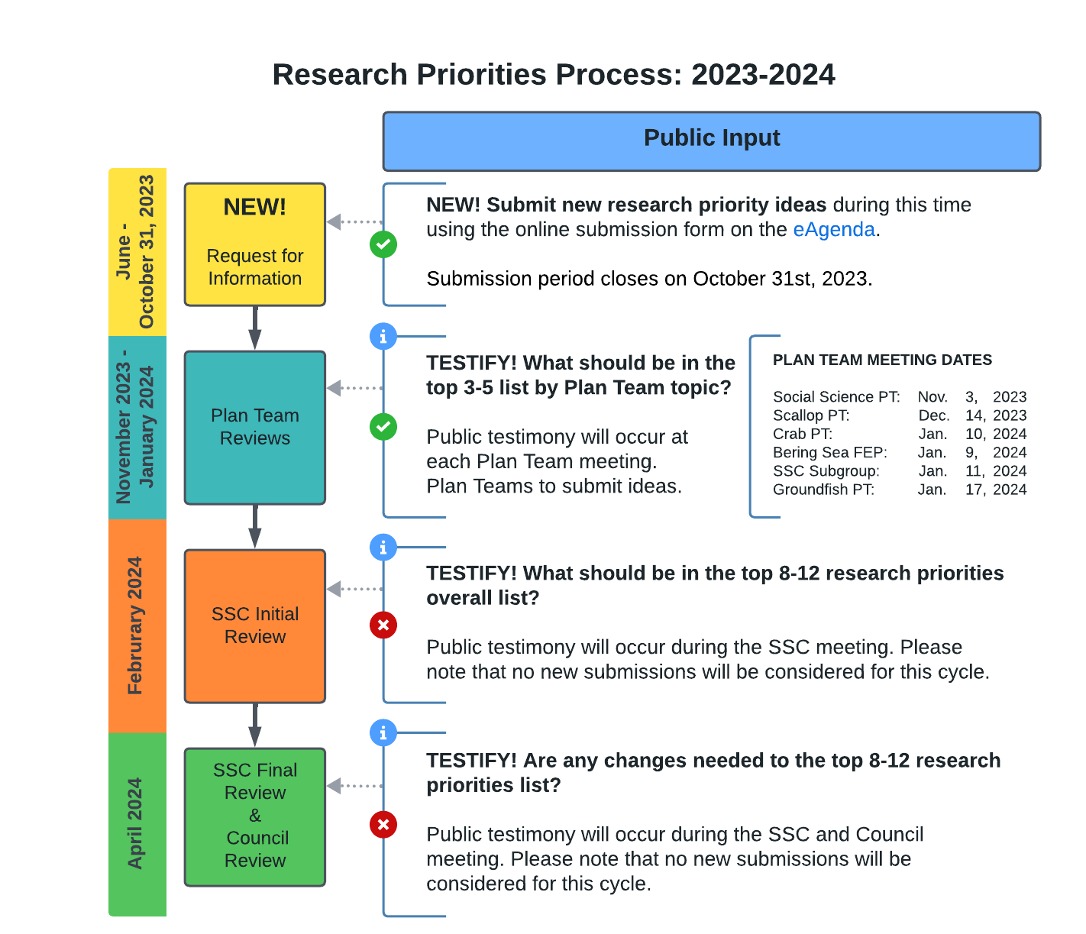

Slide 3
2024 curated Top 10-12 List (unranked)
Description | Citations | Related RIDs
Further research to reduce western Alaska salmon bycatch in Bering Sea groundfish fisheries (808). | Public, SSCsub, GPT, SSPT (Supp) | N024 (155, 156, 157, 182), N029, N031, N034, N035c, 235, SSCSub001
Quantify the magnitude of fishing gear impacts on crab and their associated benthic habitat and develop fishing gear innovations where needed (809). | Public, BSFEP, CPT, SSCsub, Council, GPT (Supp) | N025, N028, N030, N033, N039d, CPT 004, SSCSub002, Council001, BSFEP006, 235
Evaluate direct marine mammal-fishery interactions (including feeding on discards and spatio-temporal trends in bycatch) and potential mitigation measures for marine mammal conservation (810). | Public, SSCsub (Supp), GPT (Supp) | N037b, N039f, SSCsub007, SSCsub008, GPT011
* Examine the economic, social, and cultural effects of fisheries and fishery management policy on coastal communities over time (including impacts from fishery policy changes and Tribal citizen and Tribal Nation reliance on, participation in, and impacts of federally managed fisheries) (811). | Public, SSPT (x3), BSFEP, CPT (Supp) | 230, BSFEP009, SSPT003, 226, 731, N020
* Develop actionable ecosystem indicators relevant to single-species stock assessments and ecosystem assessments that address climate change impacts to managed stocks (812). | Public, BSFEP, GPT | N035a, 189, BSFEP10, GPT015
* Continue to acquire basic life history information with an emphasis on improved estimates of size/age at maturity to advance understanding of the mechanisms for how maturity changes over space and through time (813). | Public, ScPT, CPT, GPT | N008, 171, 592, CPT002, CPT003
* Increased understanding of the spatial distribution, habitat requirements, and movement of crabs relative to life history events and fishing (814). | Public, CPT, BSFEP | N003, N011, N035b, N039a, 148, BSFEP006
Develop predictive tools and models that evaluate the impact of multiple projected climate scenarios on managed resources to inform management options related to ecosystem production and resilience and adaptation of fishing communities (815). | BSFEP, GPT, CPT | 223, 225, 733, BSFEP008, GPT016, CPT006
Retrospective and meta- analysis regarding whether, how, when and why objectives and goals of fishery management plans are or are not achieved over time (e.g., Bmsy proxy evaluation) (816). | Public, SSCsub, GPT (Supp), SSPT (Supp) | N027, N032, GPT014, 365
* Norton Sound Red King Crab case study (731). | SSPT, CPT (Supp) | 731
Improve surveys in untrawlable habitat, particularly for rockfish, Atka mackerel, sculpins, and snow crab (817). | Public, GPT | N003,N017, N022, 146
Improve discard mortality rate estimates for scallops, crab, and groundfish stocks by gear types (818). | Public, ScPT | 203, N035f
* RP similar on 2021 Top list. Related RIDs: ≥800 = new/edited; <800 = existing priority; NXXX = public submission; other alpha-numeric = Plan Team submission
Notes:
This represents the curated list of research priorities in consideration for the Top 10 list for 2024 - 2027. The SSC Subgroup for research priorities reviewed all new public submissions and Plan Team recommended RPs. Additionally, the SSC subgroup revised, combined, or added to these RPs to improve clarity, reduce redundancy, and broaden topics that spanned input from multiple groups to the best of their ability. Care was taken to minimize any potential change of intent from the original RPs to the extent practicable.

Slide 4
2024 curated Top 10-12 List (unranked)
Description | Citations | Related RIDs
Further research to reduce western Alaska salmon bycatch in Bering Sea groundfish fisheries (808). | Public, SSCsub, GPT, SSPT (Supp) | N024 (155, 156, 157, 182), N029, N031, N034, N035c, 235, SSCSub001
Quantify the magnitude of fishing gear impacts on crab and their associated benthic habitat and develop fishing gear innovations where needed (809). | Public, BSFEP, CPT, SSCsub, Council, GPT (Supp) | N025, N028, N030, N033, N039d, CPT 004, SSCSub002, Council001, BSFEP006, 235
Evaluate direct marine mammal-fishery interactions (including feeding on discards and spatio-temporal trends in bycatch) and potential mitigation measures for marine mammal conservation (810). | Public, SSCsub (Supp), GPT (Supp) | N037b, N039f, SSCsub007, SSCsub008, GPT011
* Examine the economic, social, and cultural effects of fisheries and fishery management policy on communities over time (including impacts from fishery policy changes and Tribal citizen and Tribal Nation reliance on, participation in, and impacts of federally managed fisheries) (811). | Public, SSPT (x3), BSFEP, CPT (Supp) | 230, BSFEP009, SSPT003, 226, 731, N020
* Develop actionable ecosystem indicators relevant to single-species stock assessments and ecosystem assessments that address climate change impacts to managed stocks (812). | Public, BSFEP, GPT | N035a, 189, BSFEP10, GPT015
* Continue to acquire basic life history information with an emphasis on improved estimates of size/age at maturity to advance understanding of the mechanisms for how maturity changes over space and through time (813). | Public, ScPT, CPT, GPT | N008, 171, 592, CPT002, CPT003
* Increased understanding of the spatial distribution, habitat requirements, and movement of crabs relative to life history events and fishing (814). | Public, CPT, BSFEP | N003, N011, N035b, N039a, 148, BSFEP006
Develop predictive tools and models that evaluate the impact of multiple projected climate scenarios on managed resources to inform management options related to ecosystem production and resilience and adaptation of fishing communities (815). | BSFEP, GPT, CPT | 223, 225, 733, BSFEP008, GPT016, CPT006
Retrospective and meta- analysis regarding whether, how, when and why objectives and goals of fishery management plans are or are not achieved over time (e.g., Bmsy proxy evaluation) (816). | Public, SSCsub, GPT (Supp), SSPT (Supp) | N027, N032, GPT014, 365
* Norton Sound Red King Crab case study (731). | SSPT, CPT (Supp) | 731
Improve surveys in untrawlable habitat, particularly for rockfish, Atka mackerel, sculpins, and snow crab (817). | Public, GPT | N003,N017, N022, 146
Improve discard mortality rate estimates for scallops, crab, and groundfish stocks by gear types (818). | Public, ScPT | 203, N035f
* RP similar on 2021 Top list. Related RIDs: ≥800 = new/edited; <800 = existing priority; NXXX = public submission; other alpha-numeric = Plan Team submission
Notes:
This represents the curated list of research priorities in consideration for the Top 10 list for 2024 - 2027. The SSC Subgroup for research priorities reviewed all new public submissions and Plan Team recommended RPs. Additionally, the SSC subgroup revised, combined, or added to these RPs to improve clarity, reduce redundancy, and broaden topics that spanned input from multiple groups to the best of their ability. Care was taken to minimize any potential change of intent from the original RPs to the extent practicable.

Slide 5
Unobserved Fishing Mortality Working Group (UFMWG)
Main Conclusions
1) The WG has no pre-conceived notion on results of UFM research (just where it should be focused).
2) Estimating UFM will require future field studies.
3) The Fishing Effects (FE) model is a useful tool to characterize fishing activity and estimate habitat impacts but cannot currently be used to assess UFM.
4) Most of the data required to inform stock assessments models does not exist yet.
5) Further WG meetings not fruitful until some of the identified research is completed.

Slide 6
Unobserved Fishing Mortality Working Group (UFMWG)

Slide 7
Current/Future Request for Proposals
Bycatch and incidental catch (e.g., spatiotemporal distribution, ecological effects, discard mortality, and implications of management measures).
Characterization of habitat essential for spawning, nursery and feeding areas.
Impacts of fishing gears on benthic species, and the structure and function of their habitat.
Assessment of gear performance and/or innovations to monitor and minimize bycatch associated with active and ghost fishing gear.
Behavioral changes in killer whales, assessment of interactions with fishing vessels, and strategies to mitigate interactions with fishing vessels and their activities.
NPRB
2024/2025
Improve knowledge of total hatchery vs. wild chum salmon taken as bycatch in the EBS pollock fishery.
Increased information on impacts of various fishing gear on benthic habitat structure and function.
More detailed mapping of BSAI habitats and corresponding recovery times following fishing impacts through, for example, comparing areas open and closed to fishing.
PCCRC
2024/2025
Bycatch and incidental catch (e.g., spatiotemporal distribution, ecological effects, discard mortality, and implications of management measures) including fishing gear modifications
Improved understanding of unobserved mortality from all fishing gear types
Characterization of habitat essential for spawning, nursery and feeding areas
Crab Disaster
Funds

Slide 8
Current/Future Challenges
Capacity!
AK based Faculty
Grad students
ADFG staff/NOAA staff

