Slide 1
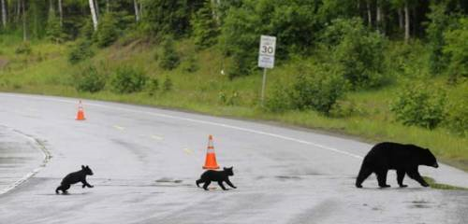

Staying Safe Around
Bears and Moose
Photo Credit: Marc Lester, Anchorage Daily News, Mayor’s Marathon, 2008
Created by the Alaska Department of Fish and Game
For Middle and High School Students

Slide 2
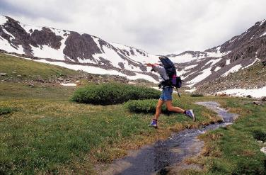
Goals
Increase overall knowledge of wildlife safety (bears and moose)
Help people mitigate risks
Keep going outside! It’s good for your health
We live a Big WILD Life in Alaska. Enjoy it!
Notes:
Many Alaskans already know a fair amount about wildlife safety. But do we really know what we’re supposed to do if suddenly find ourselves staring down a bear or a moose is chasing us? Our goal is to increase that overall level of awareness. We want people to understand their risks in bear and moose country but not to be overly “bearanoid” or “paranoid.” Being outdoors has many, many benefits. Living with wild animals such as bears or moose is a real risk but should be kept in perspective. On average, three people are killed each year in bear attacks in North America. Each mauling is tragic but you are at much greater risk just driving from your school to home, for example. Our goal is to raise your awareness and knowledge so you can hopefully avoid these animals, but also know what to do should you encounter one.

Slide 3
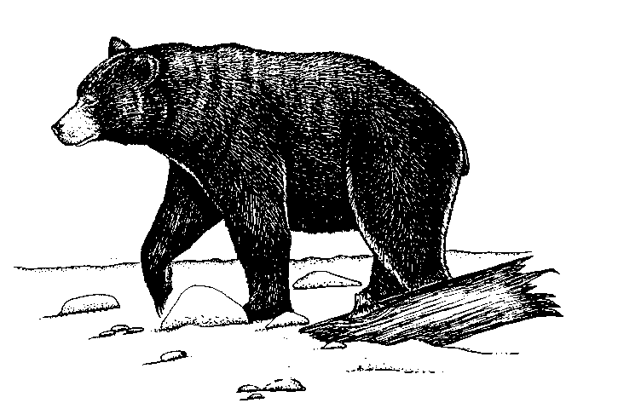
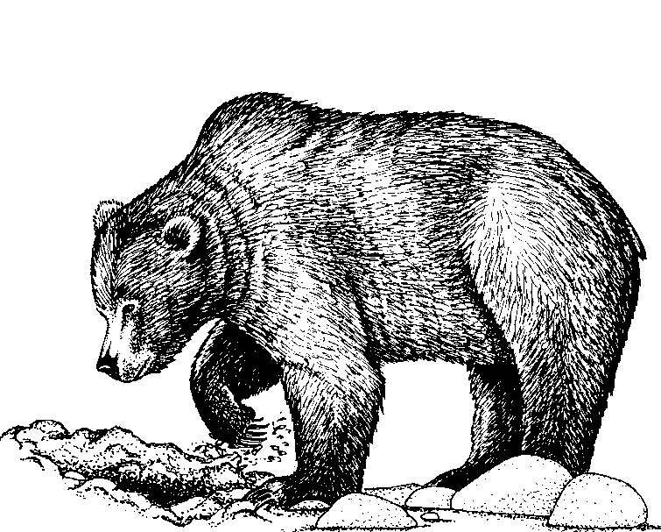
About Bears: Black vs. Brown?
Black Bears: adapted to life in life in forests. If threatened, they typically flee, hide or climb trees.
Brown Bears: evolved in treeless habitats. If threatened, they are more apt to defend.
Notes:
We have three species of bears in Alaska – all three of the species found in North America. Most communities in Alaska live near black or brown bears, or both, but only Arctic communities have polar bears, so in this presentation we cover only black and brown bears.
Being able to tell the difference between a black bear and a brown bear is not only interesting, it’s a good thing to know. Brown bears and black bears, in general, will often react differently when they feel threatened. Black bears tend to flee. Brown bears are more likely to defend themselves aggressively. So it is helpful to know what kind of bear you are facing. Also, most of you probably already know this but grizzly bears are the same species as brown bears. They are called grizzlies when they live in the Interior part of the state and brown bears when they live along the coast.
Here are some general ways to tell these two kinds of bears apart.
Color: This is not always the best indicator as hair color can vary. Brown bears can be black, or very straw colored. Black bears can be shades of brown, bluish-gray or even white.
Size: On average, brown bears tend to be larger, but not always. Male brown bears in summer might weigh between 400-1000 pounds and male black bears might weigh between 150-400 pounds.
Nose profile: Black bears tend to have straighter noses. Brown bears tend to have dish-shaped or concave noses.
Claws: Brown bears have longer straighter claws for digging. Black bears have shorter curved claws adapted for climbing. Hopefully you won’t be so close to see claws but it can help to identify tracks.
Hump: This is perhaps one of the best ways to tell from a distance. Brown bears have a hump (muscles for digging). Black bears do not.
However, keep in mind that just knowing what kind of bear it is doesn’t tell you exactly what to do. You need to observe the bear and figure out what is going on with that particular situation, black or brown.

Slide 4
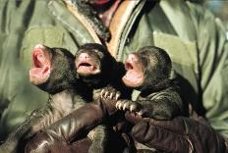
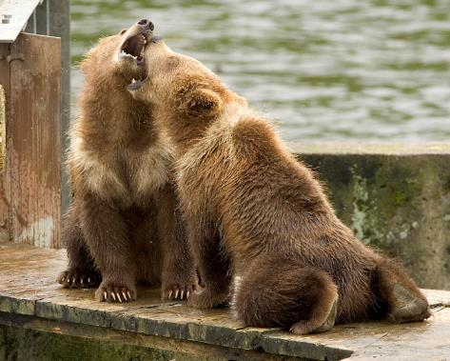
About Bears: Reproduction
Mothers raise cubs
Black bear cubs stay with mother until they are 1.5 years old on average.
Brown bears stay with mothers 2.5 to 3.5 years old on average.
Notes:
Now let’s talk a little bit about bears and their life cycle. Bears tend to be solitary except for mothers with cubs. Brown bears don’t begin to have cubs until they are about four and a half. Cubs stay with their mothers until they are two and a half to four and a half. So on average, female brown bears produce litters once every three to four years, having from one to four cubs but usually two or less. Black bear mothers keep their cubs about half as long and tend to have more cubs. Hibernation lasts from October through April or thereabouts. Bears have a relatively long life span. It is not unusual for bears in the wild to live to be 20 or even 30 years old.

Slide 5
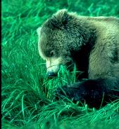
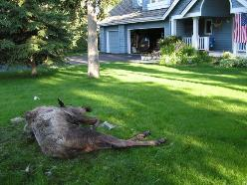
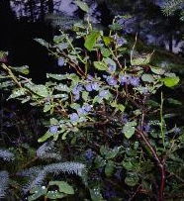
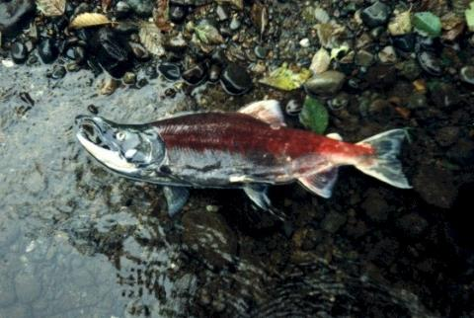
About Bears: Natural Bear Foods
Notes:
We have healthy bear populations in Alaska because there is good habitat for bears near most communities. This includes plants such as devil’s club, cow parsnip seeds, grasses, sedges, berries. Bears also eat salmon, of course. Black bears eat salmon too but brown bears tend to keep black bears off salmon streams. Both species of bear eat moose – both winter kills and moose they catch and kill.

Slide 6
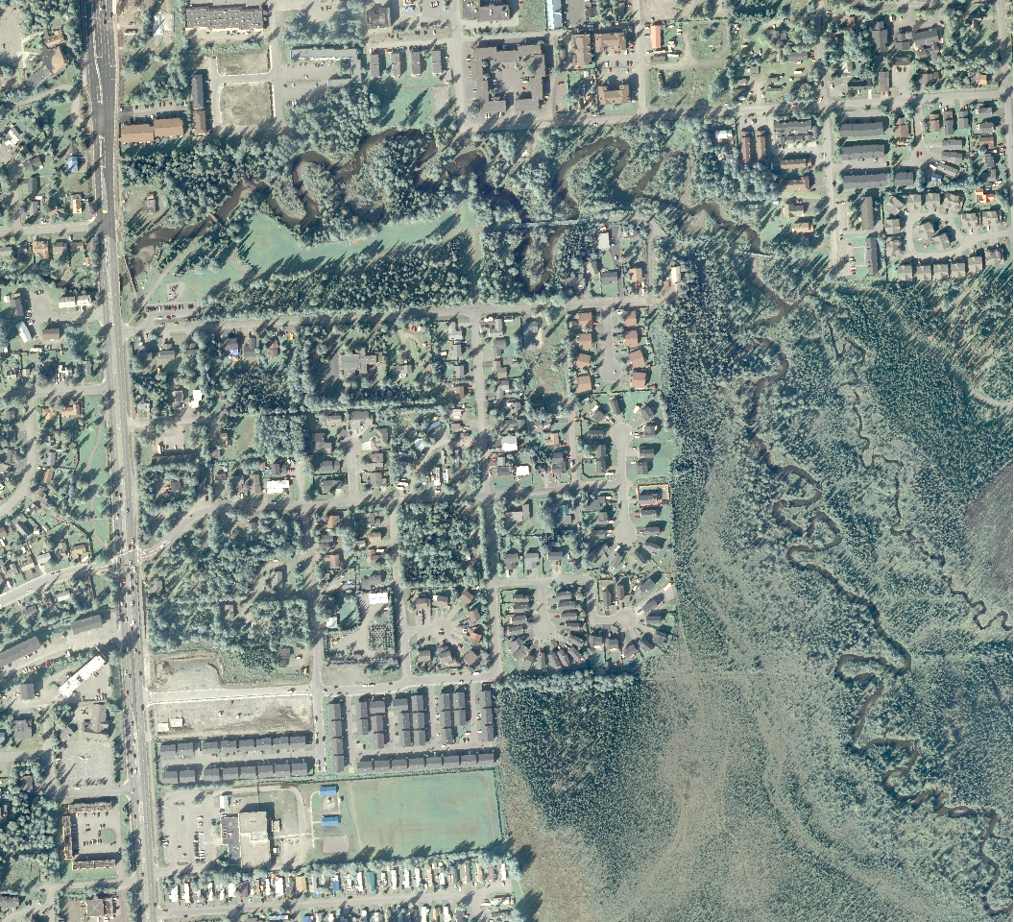
Neighborhood
Green Belt
Anadromous Stream
City
Park
Neighborhood
Notes:
This habitat is made up of a mosaic of parkland, greenbelts, and anadromous (salmon-bearing streams). This is a good map to show you why bears and people come into conflict. They like to live in the same kinds of places!

Slide 7
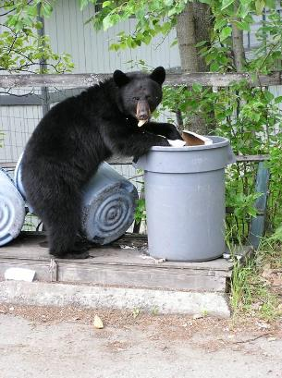
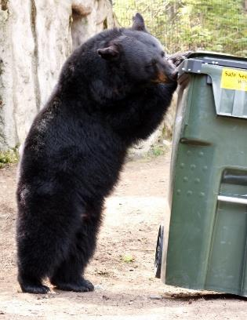
Safety Around Our Homes and Neighborhoods
Notes:
The first thing you can do is be mindful of bear attractants around your homes, particularly if you live in one of the areas frequented by bears. The number one attractant is garbage. Primarily it is the black bears that get into our garbage. ADF&G biologists estimate that if people didn’t leave out garbage or other attractants for bears, a vast number of the bear nuisance calls would go away. The bears would still be around, but they wouldn’t be cruising neighborhoods looking for food. When bears get into our garbage, they also become less afraid of being around people and may even begin approaching people.

Slide 8
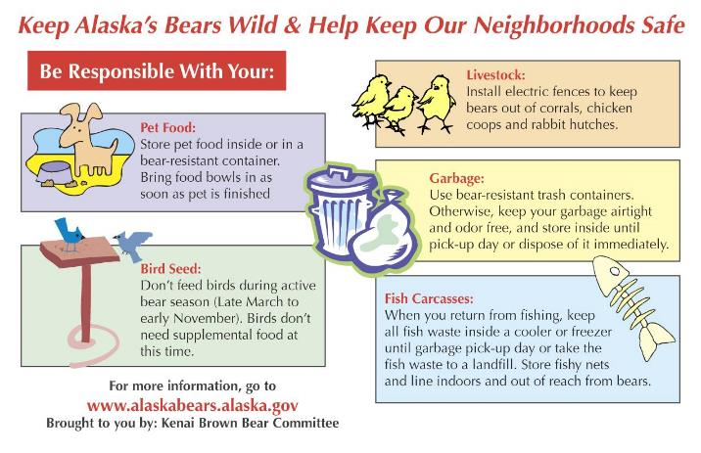
Keep all bear attractants out of reach of bears
Notes:
These are the other main attractants besides garbage and what to do to deal with them.
Pet food.
Bird seed.
Livestock.
Garbage.
Fish Carcasses.

Slide 9
Safety in Parks and On Trails
Make noise so you don’t surprise a bear!
Buddy Up. You are safer in a group
Use your senses to stay aware. No headphones!
Move cautiously, especially along creeks, on blind corners and in heavily vegetated areas
Leash your pet or leave it home
Never run from a bear!
Notes:
Next we’ll talk about safety in parks and on trails. Here are the basic messages we are hoping to get across to those who recreate in bear country. These are all basic things to do and know before you head into bear country. Groups of people are noisier than people traveling alone, and as a group, are more intimidating to a bear. Prevention and avoidance is key.

Slide 10
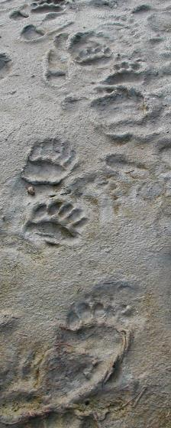
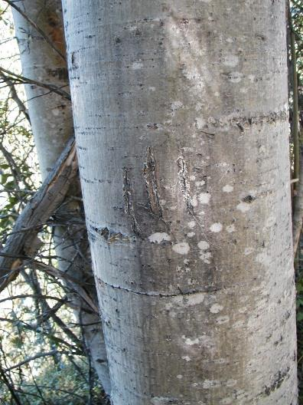
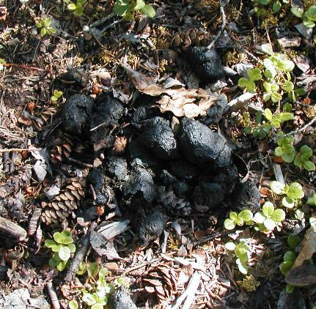
Be Alert for Bear Signs

Slide 11


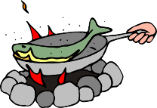
Camping
Pick a safe campsite. Avoid bear trails and areas where fish waste has been left behind.
Use a “triangle method” when possible.
Beware of narrow beaches. Allow plenty of room so bears can pass if needed.
Sleeping
WIND
Food storage
Cooking/eating
Notes:
Use a triangle method when tent camping, with your food storage and cooking areas separated from your tent by at least 100 feet or so. Pay attention to the prevailing wind direction, so cooking smells don’t get blown toward your tent.

Slide 12
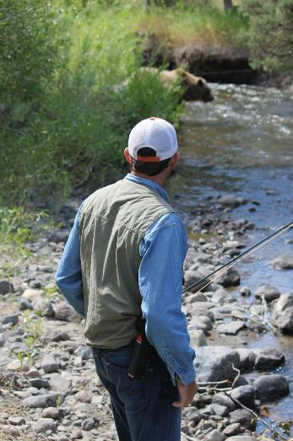
Encountering Bears
Your behavior may determine the outcome of the encounter.
Stay calm if you see a bear.
Try not to move quickly. Don’t run!
Notes:
Your behavior also teaches the bear something about humans, and shapes future encounters between that bear and other humans. Bears are smart and learn from their experiences. So you have a lot of responsibility to try to do the right thing – for your own safety, the bear’s safety and the safety of others.

Slide 13
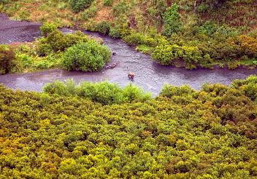
Encounters: At a distance
Enjoy watching bears from a distance
Never approach a bear!
Use a telephoto lens for photography
If the bear does not notice you, quietly leave the way you came.
Notes:
These next few slides cover just the basics of what to do if you encounter a bear. We won’t be going into great detail here because it is covered really well in the movie we’ll show next, “Staying Safe in Bear Country.”

Slide 14
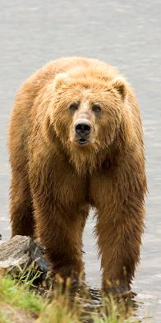
Encounters: Closer Range
Stay calm. Don’t panic. Never run from a bear!
If the bear does not notice you, move away quietly, keeping eyes on the bear
If the bear does notice you, face the bear, talk to it calmly. Group together. If you have a deterrent like bear spray, get ready to use it.
If the bear is not approaching, try to increase your distance
If a bear approaches, stand your ground. Group together. Make more noise. If you need to, use your deterrent.

Slide 15
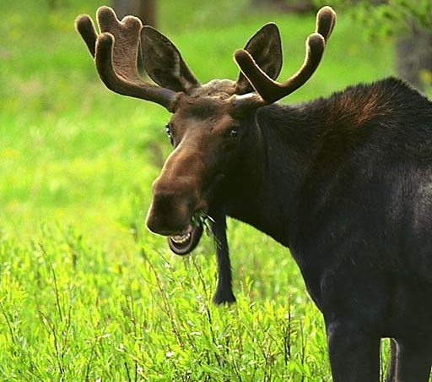
Moose Safety
Notes:
Moose safety is just as important. Bears go into dens in many parts of Alaska in winter but moose are around year-round and in some communities, their numbers grow in winter because they come closer to towns for the packed trails and available food.

Slide 16
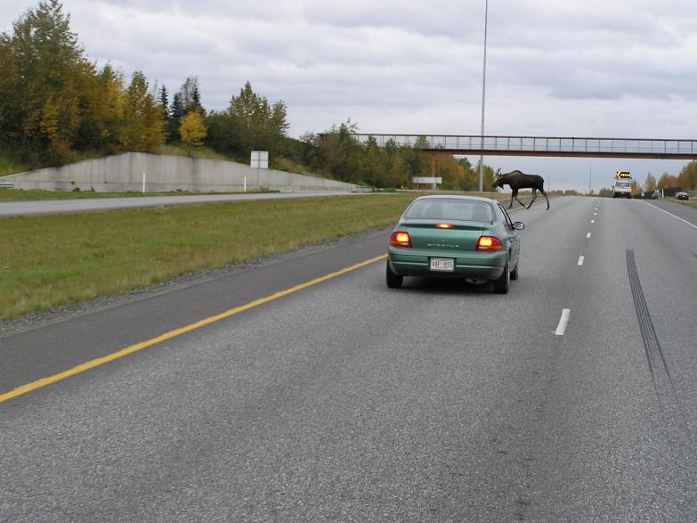
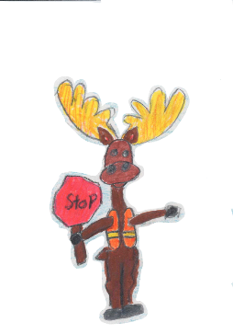
Notes:
Winter is also a time for drivers to watch out for moose. Moose-vehicle collisions are common in Alaska. For safety tips, visit http://www.adfg.alaska.gov/index.cfm?adfg=livewith.drivingmoosecountry.

Slide 17
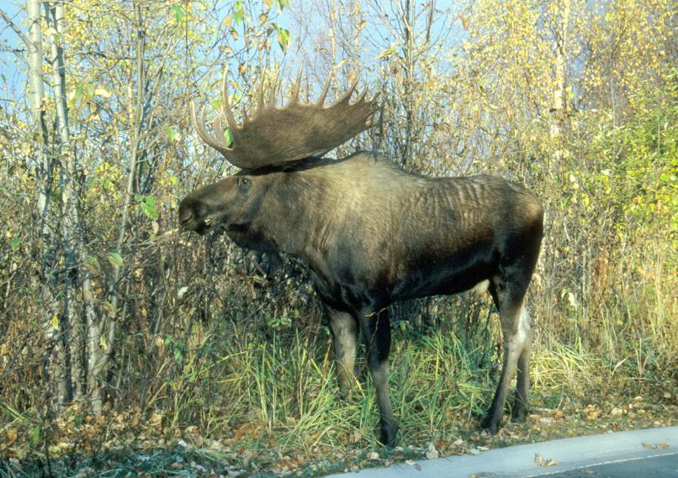
Notes:
OK. So now we’re into fall. Fall is the time of the rut, when dominant bulls gather harems of cows for breeding. The rut typically runs from September through October. It’s an important time to be extra careful around moose because they sometimes act a little crazy this time of year. Moose are usually solitary except for cows with calves, but this time of year they are often in groups. Again, give moose plenty of space. You especially don’t want to get between a bull and some cows.

Slide 18
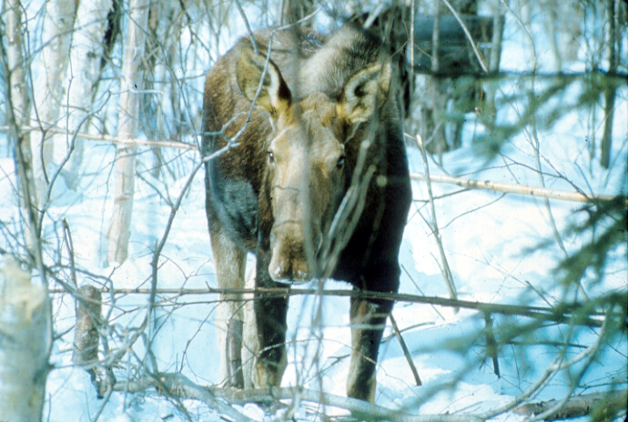
Notes:
Winter is when the moose population is highest around our schools and neighborhoods, so when we have to be most careful around moose. We’ll go over some specific tips about how to stay safe a little later but the biggest thing to remember today is to give moose plenty of space. What do moose do in winter? Mostly eat twigs and bark.

Slide 19
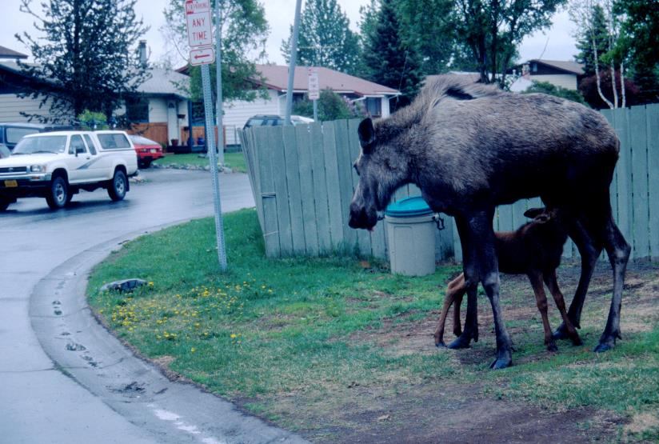
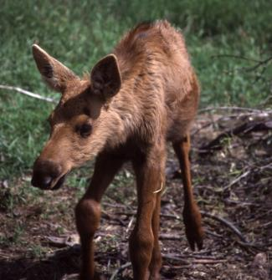
Notes:
A cow with one or more young calves is the most dangerous kind of moose. The moose is warning you that you are too close.

Slide 20
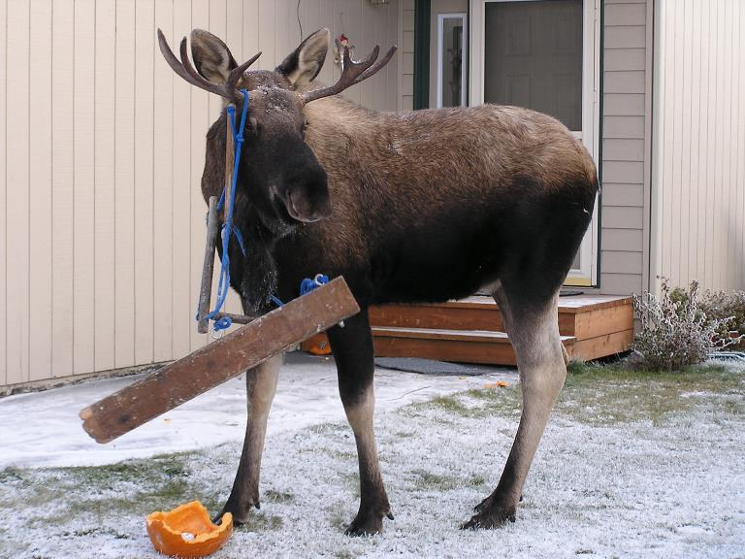
Notes:
Cow moose seldom get tangled. It’s usually the bulls in fall and early winter. Here’s one that carried off part of a swing set.

Slide 21
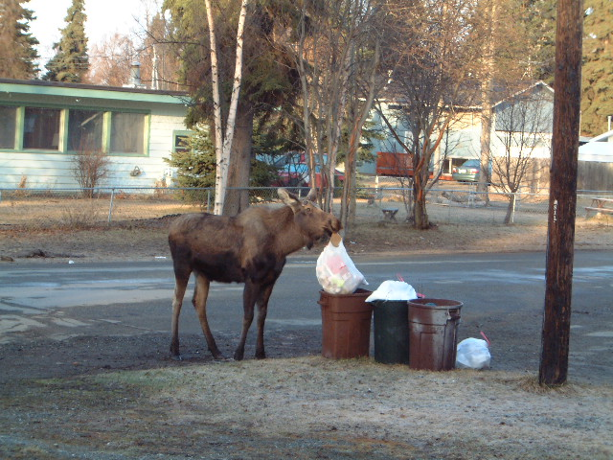
Notes:
Like bears, some moose are learning to eat our trash. They’ll eat vegetables, but they also eat meat, cereal products, and other foods.

Slide 22
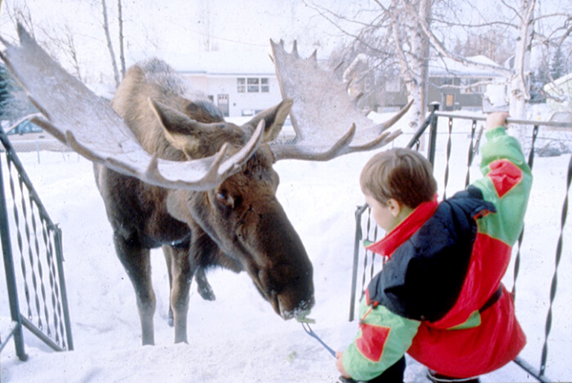
Photo by Bob Hallinen, Anchorage Daily News
Notes:
Moose that are hand-fed become extremely dangerous. They approach people expecting a handout and, when they don’t immediately get food, they can start kicking. Both kids and adults have been run down by moose that their neighbor has fed. We sometimes have to shoot these moose because they’ve become so dangerous.

Slide 23
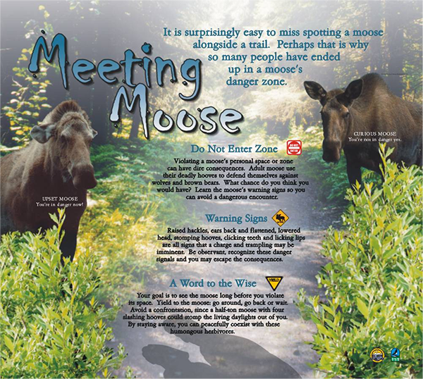
Interpretive sign by Alaska Division of State Parks and Outdoor Recreation
Notes:
Here’s a great sign designed by Alaska State Parks. We put one up near Westchester Lagoon. It discusses what to look for when you have a close encounter with a moose. Moose will often use body language to tell you when you’re too close. When the ears go back, hackles are raised, or lips are licked, the moose is warning you to get back. Moose are not normally aggressive toward people but can get ornery when they are tired of walking through deep snow, or have been harassed by people, dogs and vehicles. Kids often throw snowballs at moose or get too close. Dogs sometimes chase moose and this makes them mad too. Each moose has a different breaking point, and if they are harrassed enough, many moose will act aggressively. Speed is not always a good thing when it comes to avoiding moose attacks. When you move fast on a trail on a bike, or in-line skates, or cross-country skies, you are more likely to surprise a moose at close range. If the moose charges, you may have less time to stop and turn around. Dogs can also cause problems with moose. A loose dog can run up and bark at a moose, then run back to you with the moose close behind. Some moose just don’t like dogs, and they’ll go out of their way to attack one. As many as 50-100 dogs are kicked by moose in Anchorage every year, and some are killed.
Are moose potentially dangerous? Yes. In a sense, moose are like bees and wasps. Bee stings kill a lot more people than moose, but you don’t avoid the woods because you might be stung by a bee. You take precautions.

Slide 24
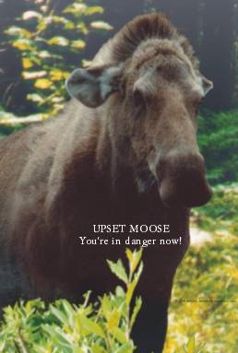
Notes:
If you were looking at this moose, you’d be way too close. See how the hair is raised on its neck and how its ears are pressed back. Pay close attention to moose body language, just as you would a strange dog. Before the moose gets this upset, it will likely stop feeding, rest or walking and will put its ears up and will look at you. This is a sign that the moose is curious, and maybe concerned about you. Give it more space.

Slide 25
Never approach wild animals!
Keep a safe distance.
THANK YOU! Have fun and be safe!
Notes:
Don’t be too worried about bears and moose. Prevention and avoidance are the most important things. Don’t ever approach a bear, or moose, and always try to travel in groups, be alert and make noise. Have fun and teach others what you know about being safe around bears and moose.

